Slide 1

Classification / Prediction

Slide 2
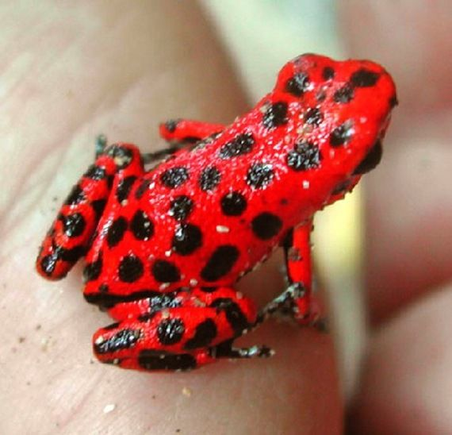
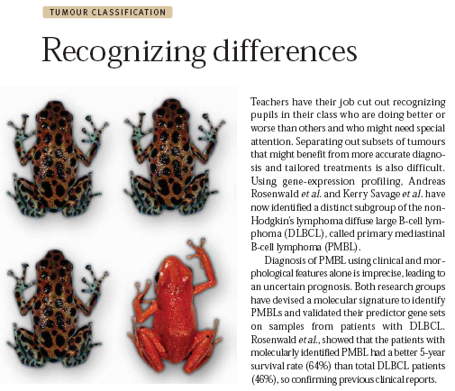
Classification
“Supervised Learning”
Use a “training set” of examples to create a model that is able to predict, given an unknown sample, which of two or more classes that sample belongs to.
?
Notes:
Classification is a type of supervised learning. Given a set a known data a model is created to predict the class of an unknown sample.

Slide 3
What we’ll cover
How to build a classifier.
How to evaluate a classifier.
Using GenePattern to classify expression data.

Slide 4
What Is a Classifier
A predictive rule that uses a set of inputs (genes) to predict the values of the output (phenotype).
Known examples (train data) are used to build the predictive rule.
Goal:
Achieve high predictive power.
Avoid over-fitting: i.e. classifier memorizes the training data and is not generalizable to other test data
Notes:
Learn a predictive rule from example

Slide 5
Classification
Computational methodology
Data
Known Classes
Select Features
Build Classifier
Test Classifier
Evaluate Classifier
Notes:
The basic approach to making a classifier looks like this;
We select features that are strongly correlated with the 2 classes
Then we use those features to build a classifier – basically code that will make a prediction about which class a sample belongs to
Then we test the classifier, and repeat, iterating until we get a good solution

Slide 6
Classification
Computational methodology
Data
Known Classes
Pick genes
Regression Trees (CART)
Weighted Voting
k-Nearest Neighbors
Support Vector Machines
Build Classifier
Test Classifier
Evaluate Classifier
Notes:
We are first going to focus on building the classifier. GenePattern supports several classification and prediction algorithms such as CART, KNN, SVM
as well as two algorithms specifically geared towards proteomics analysis ( in BlastTrainTest and ModEcoC )

Slide 7
Classifiers
Important issues:
Few cases, many variables (genes)
redundancy: many highly correlated genes.
noise: measurements are very imprecise.
feature selection: reducing the # of genes is a necessity.
Avoid over-fitting
Notes:
In the breast cancer dataset we will be using we have around 60 thousand gene transcripts, but only 50 total samples
Many of those genes are redundant. What this means is that for genes that participate in a biochemical pathway together, they may all move up or down together, so if you have one of those genes in your classifier, adding the others doesn’t really add any additional information to make the decision on, but it might add a bit of noise
So what we need to do is to reduce the number of genes to the smallest number that we can get away with, or more precisely, the smallest set of genes that each contribute more information to make a decision on then they do noise.
We also need to avoid overfitting. This is when a classifier essentially memorizes the inputs. This will work perfectly on your training data, but will generally fail badly when you give it a new test set.
Think of it like this; if you were building a classifier to recognize if the picture of a face is of a male or a female, and it only memorized the faces of the 20 people you gave it pictures of, when you give it a picture of the 21st person it has no way to determine whether it’s a boy or a girl. All it really knows is that this is not a person that it already knows.

Slide 8
k Nearest Neighbors (kNN) Classifier
Example: k=5, 2 genes, 2 classes
project samples in gene space
class black
gene 2
class orange
gene 1
Notes:
So lets start looking at building a classifier using KNN which stands for K nearest neighbors. In this case, K stands for the number of neighbors that we will look at at one time.
For this example, we’ll only measure 2 genes
We will start with a training set of data that includes 39 samples which are already known to be either orange or black.
Remember that our classifier normally cannot see the orange or the black. Its colorblind, all it knows is the expression values of gene 1 and gene 2 but since this is our training set and since this is ‘supervised’ learning, we tell it which of our training samples are orange and which are black.
So lets see how this works with our a priori choice to use K = 5, that is we’ll look at the 5 nearest neighbors…

Slide 9
kNN Classifier
Example: k=5, 2 genes, 2 classes
project unknown sample
class black
gene 2
class orange
?
gene 1
Notes:
Given an unknown sample, how can we predict what class it belongs to?

Slide 10
kNN Classifier
Example: K=5, 2 genes, 2 classes
"consult" 5 closest neighbors:
- 3 black
- 2 orange
class black
Distance measures:
Euclidean distance
1-Pearson correlation
…
gene 2
class orange
?
gene 1
Notes:
There are many measures of distance. The most intuitive is Euclidean, which is the geometric distance between 2 points. But correlation is also often used.
In this case, the sample would be labeled as black.

Slide 11
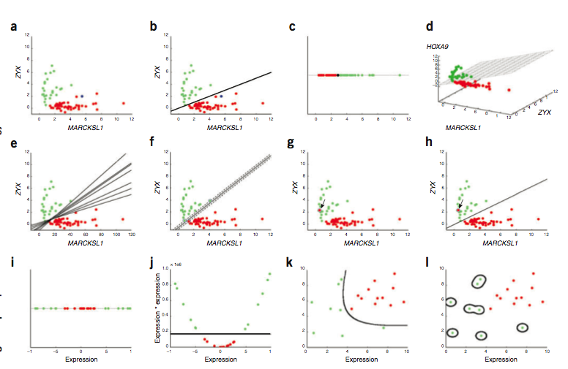
Support Vector Machine (SVM)
Noble, Nat Biotech 2006
Notes:
Note the bottom row. For some data (e.g. figure i) you cannot draw a line that seperates the red from green. SVM will try to transform the data (e.g. figure J ) to construct a seperating line and then project that line back into the untransformed space (figure k). If you take this too far (figure L) you get overfitting which looks like this.
A SVM maps input vectors to a higher dimensional space where a maximal separating hyperplane is constructed
Parallel hyperplanes are constructed on each side of the hyperplane that separates the data
The separating hyperplane is the hyperplane that maximizes the distance between the parallel hyperplanes
Assumes that a larger margin or distance between the parallel hyperplanes results in a classifier with a better generalization error

Slide 12
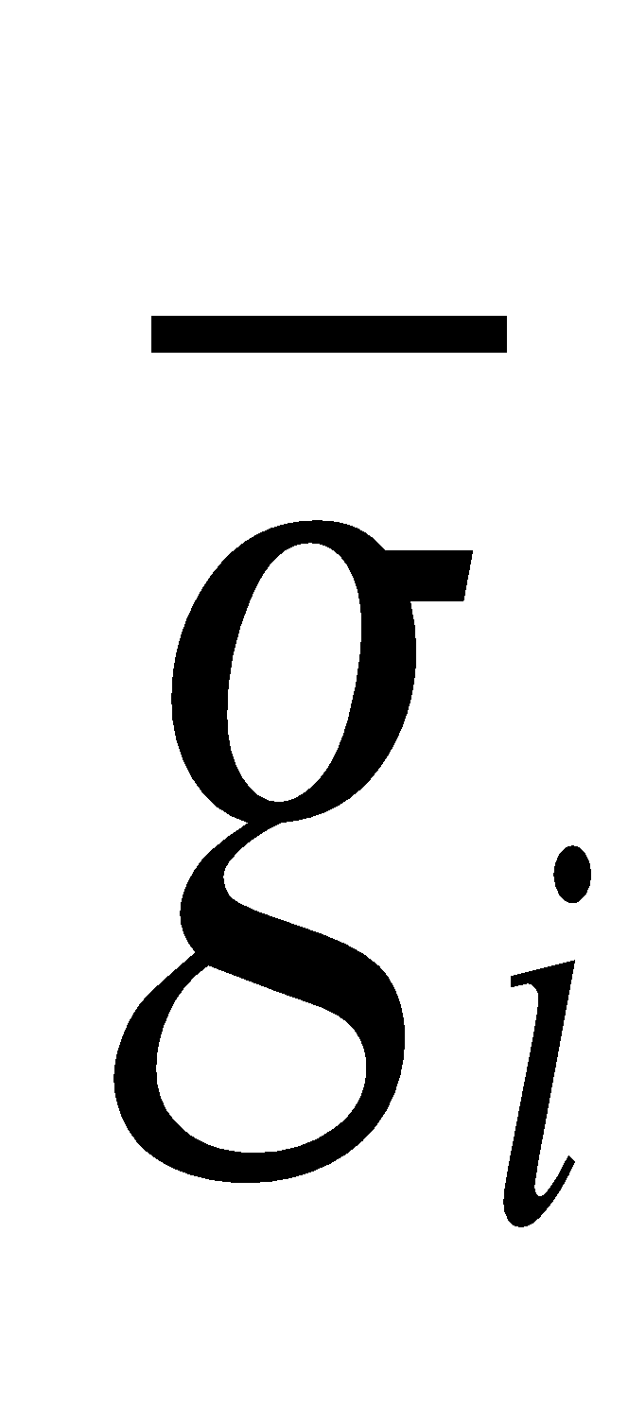
Weighted Voting
Mixture of Experts approach:
Each gene casts a vote for one of the possible classes.
The vote is weighted by a score assessing the reliability of the expert (in this case, the gene).
The class receiving the highest vote will be the predicted class.
The vote can be used as a proxy for the probability of class membership (prediction strength).
new sample
Class 1 centroid
Class 2 centroid
g₁
g₂
…
g_{i}
…
g_{n-1}
g_{n}
g₁
g₂
…
g_{i}
…
g_{n-1}
g_{n}
?
Slonim et al., RECOMB 2000

Slide 13
Class Prediction
Computational methodology
Expression Data
Known Classes
Assess Gene-Class Correlation
Feature Selection
Regression Trees (CART)
Weighted Voting
k-Nearest Neighbors
Support Vector Machines
Build Predictor
Test Predictor by Cross-Validation
Evaluate Predictor on Independent Test Set

Slide 14
Testing the Classifier
Evaluation on independent test set
Build the classifier on the train set.
Assess prediction performance on test set.
Performance measure
error rate =
# of cases correctly classified
total # of cases
Notes:
So in practice here is what you would do. You would find another set of data, which we’ll call the test set. For this set we need to know which class, orange or black, a sample belongs to, but we do not use any of these samples when we train our classifier.
What we want is a classifier with good generalization and no overfitting. In practice this means that it makes good predictions and can handle data it has not seen before
The error rate is the best measure of a classifier, simply the number of times it gets the prediction right out of the number of predictions it made

Slide 15
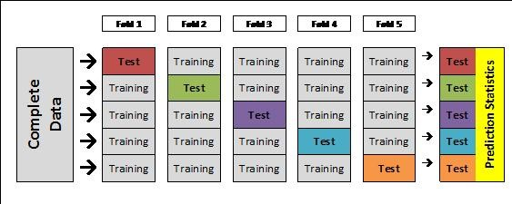
Testing the Classifier
Evaluation on independent test set
What if we don’t have an independent test set?
Cross Validation (XV):
Split the dataset into n folds (e.g., 10 folds of 10 samples each).
For each fold (e.g., for each group of 10 samples),
train (i.e., build model) on n-1 folds (e.g., on 90 samples),
test (i.e., predict) on left-out fold (e.g., on remaining 10 samples).
Combine test results.

Slide 16
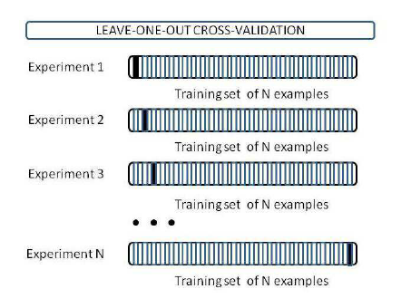
Testing the Classifier
Usually we use leave one out cross-validation
Notes:
The error rate is the averaged error rate across all of those experiments – IE how many times did the classifier get it right / # of experiments

Slide 17
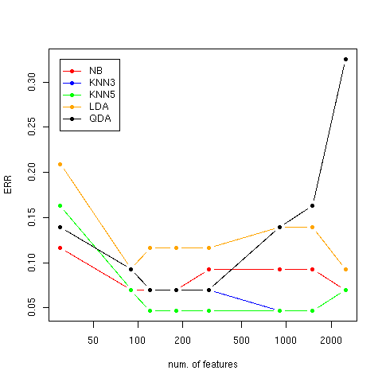
Testing the Classifier
Learning curves – leave one out cross validation
ALL vs. MLL vs. AML
More features are not always better…
Notes:
On ALL/MLL/ALL dataset
Key point – as # features increase accuracy does not but you may be adding noise to the picture
Everyhing will climb as you move out
Low features - miss some intersting stuff
Too many features and you overfit
- since LOO you get better and better training performance but the one prediction gets worse, add genes that are correlated but add nothing to the prediction except noise
Some classifiers are more sensitive to overfitting (eg GDA). KNN is not too bad

Slide 18
Classification
GenePattern methods
Split data into train and test set – SplitDatasetTrainTest
Explore different feature selection methods and different classifiers on train set by cross validation.
CARTXValidation
KNNXValidation
WeightedVotingXValidation
SVM
Once the “best” classifier and best classifier parameters have been selected (based on cross validation)
CART
KNN
WeightedVoting
SVM
Examine results:
PredictionReultsViewer
FeatureSummaryViewer

Slide 19
References
Golub, T.R., et al., Molecular Classification of Cancer: Class Discovery and Class Prediction by Gene Expression. Science, October 15 1999. 286(5439): p. 531-537.
Quackenbush, J., Computational Analysis of Microarray Data. Nature Reviews Genetics, June 2001. 2: p. 418-427.
Tibshirani, R., et al., Diagnosis of multiple cancer types by shrunken centroids of gene expression. PNAS, 2002. 99(10): p. 6567-6572.
Slonim, D.K., et al., Class Prediction and Discovery Using Gene Expression Data, in RECOMB 2000: The Fourth Annual International Conference on Research in Computational Molecular Biology. 2000: Tokyo, Japan. p. 263-272.
Ramoni, M.F., P. Sebastiani, and I.S. Kohane, From the Cover: Cluster analysis of gene expression dynamics. PNAS, 2002. 99(14): p. 9121-9126.
Savage, K.J., et al., The molecular signature of mediastinal large B-cell lymphoma differs from that of other diffuse large B-cell lymphomas and shares features with classical Hodgkin's lymphoma. Blood, 2003. 102(12): p. 3871-3879
…

Slide 20
Classification Notebook
In the Notebook Repository, locate the notebook titled 2018-02-05_06 BroadE Classification and Prediction – RNAseq
Click on this notebook.
Select “Get a copy”.
Follow along with me

Slide 21
Break (15 minutes)

